Slide 1

Part 1: Business Rules Overview

Slide 2
What is a BRMS?
What is a BRMS?
Notes:
2

Slide 3
Example
INSURANCE COMPANY
Insurance Claim

Slide 4
Example
Problems:
1. Business rules are hidden
in applications
INSURANCE COMPANY
Insurance Claim

Slide 5
Example
Problems:
1. Business rules are hidden
in applications
2. It takes too long to
change business rules
INSURANCE COMPANY
Insurance Claim

Slide 6

Example
Problems:
1. Business rules are hidden
in applications
2. It takes too long to
change business rules
3. People interpret rules inconsistently
INSURANCE COMPANY
Insurance Claim

Slide 7
The BRMS Solution

Slide 8
The BRMS Solution
Separate the business rules from the applications
Rule
Repository

Slide 9
The BRMS Solution
AHA!
Rule
Repository
1. Separate the business rules from the applications
Express rules in terms that the business can readily understand

Slide 10
The BRMS Solution
AHA!
Rule
Repository
1. Separate the business rules
from the applications
Express rules in terms that the business can readily understand
Empower business and IT experts to collaborate
4. Support all the rules

Slide 11
BRMS Components
Authoring Tools for Business Users
Business Analysts
Repository
Facts
Business
Rule
Definitions
Decision
Service
Enterprise Applications
Decisions
Authoring Tools for Developers
Business
Data
Developers

Slide 12
Introducing JBoss BRMS 5.3
Notes:
12

Slide 13





Community Powered Innovation
www.jboss.org
Business Process Management
Rule Engine
Event Processing & Temporal Reasoning
Business Rules Manager

Slide 14
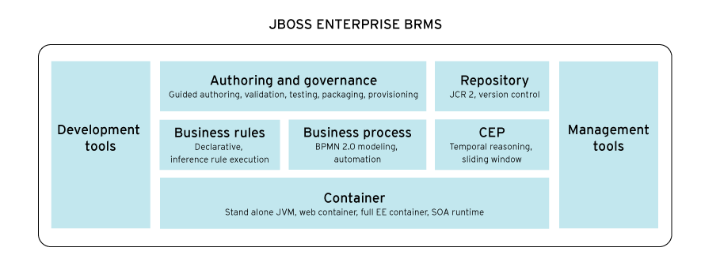
Introducing JBoss BRMS 5.3
A Single Distribution for Business Rules Management, Business Process Management and Complex Event Processing
Features
Highly flexible and customizable
Tools for business users and developers
Open, standards-based
Benefits
Enables improved, automated business processes & decisions
Enables business agility

Slide 15
BRMS Components
Business Events
Authoring Tools for Business Users
Enterprise Applications
Business Analysts
Repository
Event Processor
Business Process
Manager
Web Services
Business
Rule
Definitions
Rule Engine
Java
Authoring Tools for Developers
Developers
Business Central
Business
Data
Business Users
Operations

Slide 16
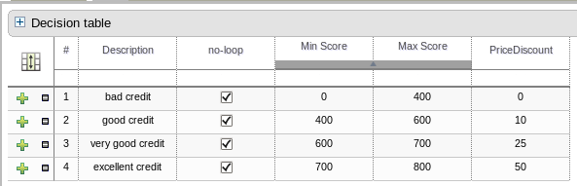
BRMS Components
Business Events
Authoring Tools for Business Users
Enterprise Applications
Business Analysts
Repository
Event Processor
Business Process
Manager
Web Services
Business
Rule
Definitions
Rule Engine
Java
Authoring Tools for Developers
Developers
Business Central
Business
Data
Business Users
Operations

Slide 17
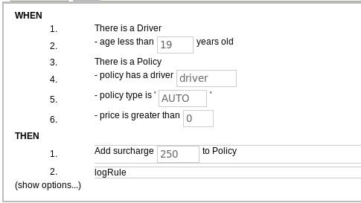
BRMS Components
Business Events
Authoring Tools for Business Users
Enterprise Applications
Business Analysts
Repository
Event Processor
Business Process
Manager
Web Services
Business
Rule
Definitions
Rule Engine
Java
Authoring Tools for Developers
Developers
Business Central
Business
Data
Business Users
Operations

Slide 18
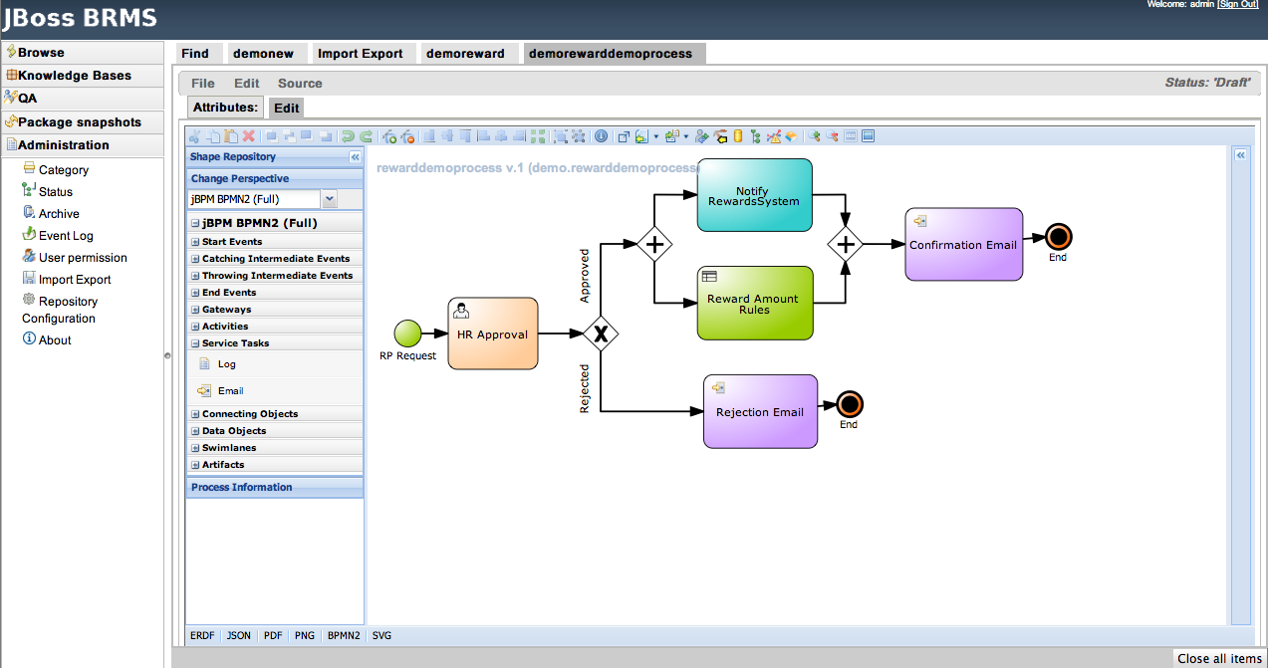
BRMS Components
Business Events
Authoring Tools for Business Users
Enterprise Applications
Business Analysts
Repository
Event Processor
Business Process
Manager
Web Services
Business
Rule
Definitions
Rule Engine
Java
Authoring Tools for Developers
Developers
Business Central
Business
Data
Business Users
Operations

Slide 19
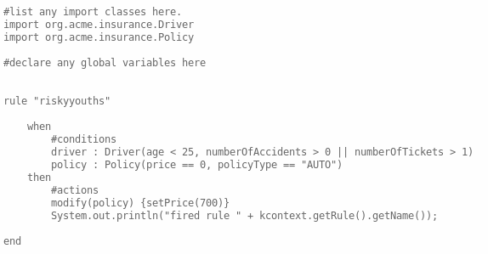
BRMS Components
Business Events
Authoring Tools for Business Users
Enterprise Applications
Business Analysts
Repository
Event Processor
Business Process
Manager
Web Services
Business
Rule
Definitions
Rule Engine
Java
Authoring Tools for Developers
Developers
Business Central
Business
Data
Business Users
Operations

Slide 20
BRMS Value Proposition Top 4 “Take Aways”
JBoss BRMS 5.3 combines Rules, BPM and Complex Event Processing enabling automation of a wide range of business activities
JBoss BRMS facilitates close collaboration between business and IT users enabling more agile business
JBoss BRMS delivers capabilities on par with prominent, proprietary offerings at a fraction of the cost
JBoss BRMS is open source, with subscription pricing that scales from SMBs to large enterprises
Notes:
Reviewing what we’ve discussed today...

